Slide 1
Welcome to 266
Introduction

Slide 2
In this class we will...
Develop intuition for computational linguistics
Learn about neural network architectures
Learn about NLP tasks and their problem structures
Emphasize practical understanding
You will also do a project that requires you to address an NLP task (and associated data set) with a particular network architecture and a specific problem structure

Slide 3
By the End of the Class, You Should...
Understand how to operationalize NLP tasks
Understand how to design experiments around language processing
Understand how to architect and implement suitable neural net models with Keras/Tensorflow to address a given language task
Understand how to find techniques for unfamiliar language problems
Get pretty close to understanding the most recent NLP research articles

Slide 4
Note
We want to focus on more interaction in the live session.
We plan to use the async as a springboard so please view before your live session.

Slide 5
266 Natural Language Processing
Week 1: Introduction

Slide 6
Peeking Ahead
Week 1: Introduction
Week 2: Text Classification
Week 3: Language and Context
Week 4: Pretrained Transformers
Week 5: Text Generation Models
Week 6: Machine Translation
Week 7: Question Answering & Summarization
Week 8: Linguistic Representation
Week 9: Entities and Linking
Week 10: Embedding-based Retrieval
Week 11: Multimodality in NLP
Week 12: ML Fairness and Privacy
Week 13: NLP in the Real World

Slide 7
This Week
Core Components
Basics of the class and its structure
Review of basic neural nets
Some language complexities
How to think about NLP tasks
Non-Goals
Teach fundamentals of deep learning from scratch

Slide 8
Class Overview & Its Structure
Introduction

Slide 9
TL;DR:
(You’ll need to read the syllabus in detail to answer A0 questions.)
Grading: Assignments + Project
Project: Start thinking about the project soon (see Project GitHub page)
Assignments: … Five in total? Some bigger than others!
Extensions on Assignments: Use your late days

Slide 10
Resources
Seven sections, but we’ll share resources.
Ed Discussion for Q&A: Link from bCourses
Keep questions on Ed Discussion (you can mark “Anonymous”)
Keep questions public unless they include assignment solutions
Oh noes, the sky is falling! Email instructor list and cc student support
Syllabus:
https://github.com/datasci-w266/2024-spring-main/tree/master/syllabus

Slide 11
Resources
The class git repo contains several directories of interest:
Review materials
https://github.com/datasci-w266/2024-spring-main/materials/prelim
Lesson notebooks
https://github.com/datasci-w266/2024-spring-main/materials/lesson_notebooks
Walkthrough notebooks
https://github.com/datasci-w266/2024-spring-main/materials/walkthrough_notebooks

Slide 12
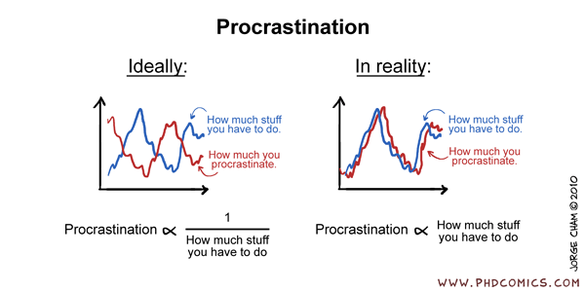
Advice...
START EARLY!
These assignments and project are TRICKY!

Slide 13
Announcements
Assignment 0 (Setup) - released soon
Due Sunday, Jan 21
Assignment 1 (NN) to be released Friday 01/19
Due Sunday, Jan 28 (Tuesday 01/30 if you use late days)
Project Proposals - Due (02/18)!
Will discuss details in two weeks
Questions?
Concerns?

Slide 14
Announcements
Paper reading sessions:
How to read a paper and A Sensitivity Analysis of (and Practitioners' Guide to) Convolutional Neural Nets for Sentence Classification
Mark: Tuesday 01/23 5:30 pm PST
oLMpics-On What Language Model Pre-training Captures
Mark: Tuesday 01/30 5:30 pm PST
Notebook Walkthroughs:
TBD
TBD
Questions?
Concerns?

Slide 15
Key Learnings Review: Neural Nets
Introduction

Slide 16
NLP Review
Every week we’ll discuss a couple of questions about NLP tasks, structures, and architectures.
This is an opportunity to reinforce previous lessons and help build your intuition around language processing.

Slide 17

Networks and Matrices
H
X
H
Q
H
One Neuron (Unit)
H
Q
X
H
x₁
(w₃₁*x₁) + (w₃₂*x₂)
relu(z)
b
x₂
=
z
Image Source: https://towardsdatascience.com/activation-functions-neural-networks-1cbd9f8d91d6
Notes:
Pink = input (x)
w = weighted sum of inputs
b = bias term
z = logit

Slide 18
Networks and Matrices
H
X
H
Q
H
H
Q
X
H
W₀
W₁
W₂
relu(z₀)
relu(z₁)
?
x
x
x
q
+
=
+
z₀
=
=
+
z₁
z₂
b₀
b₂
b₁
What are the dimensions of W, b, and z in each layer?
Notes:
Pink = input
H1 = blue
H2 = yellow
Output = green
X0*W0 + b0 (1*3)) = Z0 (1024 * 3)
np.dot(X0, W0) + b0 = Z0

Slide 19
Networks and Matrices
H
X
H
Q
Example Dimensions: ∑_{i} x_{i} W_{ia} + b_{a}= z_{a}
2d x (2, 3)d -> 3d
H
H
Q
X
H
W
W
W
relu(z)
relu(z)
?
x
x
x
q
+
=
+
=
z
=
=
z
+
z
z
b
b
b
b
Notes:
Pink = input
H1 = blue
H2 = yellow
Output = green
[1,2,3]
+
[4,5,6]

Slide 20
Networks and Matrices
H
X
H
Q
H
H
Q
X
H
W
W
W
relu(z)
relu(z)
?
x
x
x
x
q
+
=
+
=
=
=
z
=
z
+
z
z
z
b
b
b
b
Notes:
Pink = input
H1 = blue
H2 = yellow
Output = green

Slide 21
Networks and Matrices
H
X
H
Q
H
H
Q
X
H
W
W
W
?
relu(z)
relu(z)
x
x
x
q
+
=
+
z
=
=
+
z
z
b
b
b
Multiclass Classification
Notes:
Pink = input
H1 = blue
H2 = yellow
Output = green
Multiclass classification means we use softmax as the non-linearity

Slide 22
Networks and Matrices
H
X
H
Q
H
H
Q
X
H
W
W
W
?
relu(z)
relu(z)
x
x
x
q
+
=
+
z
=
=
+
z
z
b
b
b
Binary Classification
Notes:
Pink = input
H1 = blue
H2 = yellow
Output = green
Binary classification means we use sigmoid as the non-linearity

Slide 23
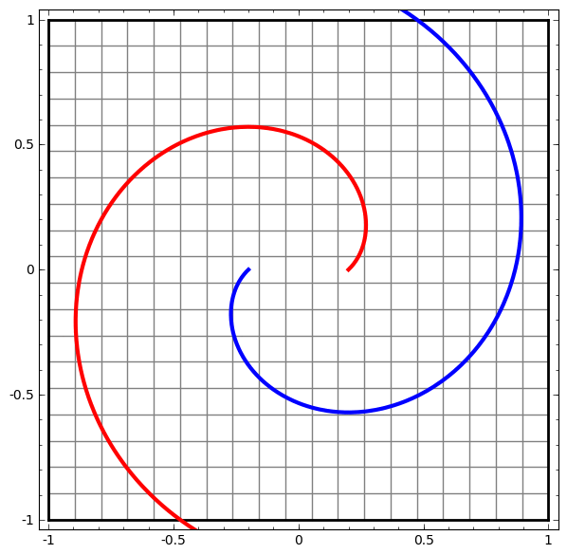
Neural Nets
Sigmoid Or Softmax
Output layer
(“softmax layer”)
Affine
Nonlinearity
Fully-connected layer 2
Affine
z = xW + b
dim(x) = k
dim(z) = m
shape(W) = k x m
dim(b) = m
Affine
Nonlinearity
Fully-connected layer 1
Affine
x₁ x₂

Slide 24
Neural Nets
Sigmoid Or Softmax
Questions:
What is the dimension of the output layer?
What is Softmax to begin with?
What is a suitable cost function for classification tasks? (See discussion in Extra Material)
How are neural nets trained? What is the idea?
Output layer
(“softmax layer”)
Affine
Nonlinearity
Fully-connected layer 2
Affine
z = xW + b
dim(x) = k
dim(z) = m
shape(W) = k x m
dim(b) = m
Affine
Nonlinearity
Fully-connected layer 1
Affine
x₁ x₂
Notes:
Not to be confused with how batteries work

Slide 25
Representing Words in Neural Nets
Introduction

Slide 26
Words as Vectors
Synonyms: car vs automobile
Multiple meanings, depending on context:
“She had quite a fall when she tripped.”
“That hair was allowed to fall on the shoulders.”
“The first fall on the hike was really great!”
“That fall Roosevelt was elected.”
…
Questions:
How can we use neural nets for language? Don’t neural nets expect numbers as inputs?
What can we do to tackle this problem? What is the main idea?

Slide 27
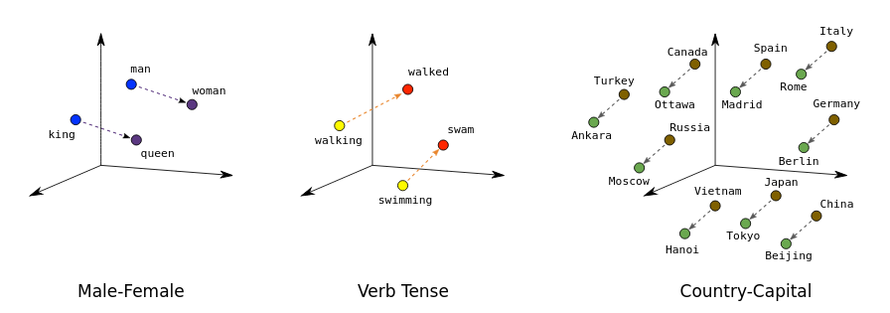
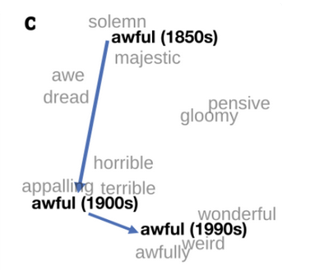
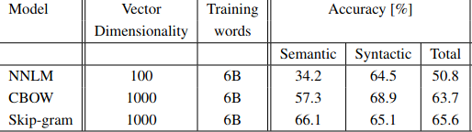
Word Embeddings
Cool properties of embeddings
Change of embeddings over time
Image Source: developers.google.com
Image Source: William L. Hamilton, Jure Leskovec, Dan Jurafsky, https://arxiv.org/pdf/1605.09096.pdf
CBOW vs Skip-gram (partial table from https://arxiv.org/pdf/1301.3781.pdf)
Notes:
Old version : [0,0,0,1,0,0,0,..]
New version : [0.1, 0.03, 0.074,…

Slide 28
How to train?
Training word representations w/o a supervised task
Key idea Word representations should predict their context and vice versa. Mechanisms
Skip-gram: Train representations to predict context around a word CBOW: Train representation to predict word from surrounding context
Notes:
Distributional hypothesis: let’s try to learn meaning of words (as vector representation), by predicting the words around them.

Slide 29
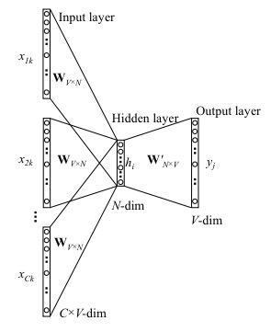
CBOW - Continuous Bag-of-Words
Predicts a word given its context - P(word|context)
1.“Embeddings empower [mask] accurate classification”
2.“Embeddings empower less accurate classification”
3.“Embeddings empower spaceship accurate classification”
Mechanism Predict middle word using avg. context representation:
Maximizes P(word | avg(context))
P(more| avg(embeddings, empower, accurate, classification))
Learn W and W’ matrices - W is embedding matrix
Word2vec parameter learning explained
Notes:
RAW = “It’s raining cats and dogs”
X = [“it’s”, “raining”, —-, “and”, ”dogs”]
y = “cats”
(really, y = one-hot encoding for the word “cats”)

Slide 30
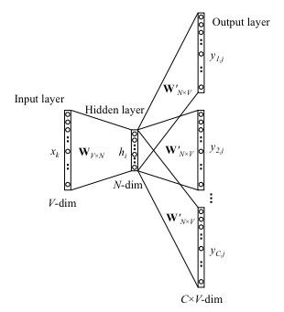
Skip-Gram Model
Predicts context around a word - P(context|word)
“Embeddings empower more accurate classification”
Mechanism
Randomly samples R words from context window
Positive word pairs (more, embeddings)(more, empower) AND negative word pairs
Maximizes P(context_{i∈R} | word_{t})
Learn W and W’ matrices - W is embedding matrix
Word2vec parameter learning explained
Notes:
[0 1 0 0 0 0 0 0 … ]
[0 0 1 0 0 0 0 0 … ]
y’ = h*W’ = [0 ? ? 0 0 0 0 0 ….]
[0 0 1]
[0 1 0]
[1 0 0]

Slide 31
Mathematically equivalent: one-hot & word vectors
Usually presented as a “lookup” in some table, but…
(Only) think of a word as a “one-hot vector:”
X = [0 0 1 … 0 0 …. 0 0 0] ← 10k dimension?
Then we do matrix multiplication:
“the”
E =
0 0 1 0 0 0 0
W
X
Vector for “the”
Word Embeddings!
Reasonable that similar words end up with similar vectors
Notes:
Key idea: map discrete things (words) into a continuous feature space.
Conceptually, just a big matrix multiply. But since one-hot vector is very sparse, convenient to just extract the column by indexing. So often we’ll refer to this as a “lookup”. (In fact, you can even shard embeddings across different servers, and just pull in the one you need!)
This image doesn’t tell us how the matrix W is trained. We cover that separately. Once it’s trained though, we can use the above to efficiently go between word, one-hot, and dense representation (word vector)

Slide 32
Neural Nets & Keras/Tensorflow
Introduction

Slide 33
Notebooks
Simple NN Notebook
Neural Net Review

Slide 34
Notebooks
Simple NN Notebook
Word Embeddings and Analogies

Slide 35
Async Prompts Review
Introduction

Slide 36
Async Prompt Review
Some weeks we’ll discuss the prompts at the end of the async for the week.
After watching the async you should be able to answer these questions. We’ll discuss answers at the beginning of the live session.

Slide 37
Async Prompt Review
Imagine you’re training a classification model based on a sequence of input features.
Describe what the final layers of your network look like.
What loss function might you use?
What might you do if the loss just increases?
Why not just use one-hot feature vectors for categorical variables rather than bothering with “embeddings”?
Assuming no regularization, what is the gradient of the loss function with respect to the embedding of a categorical variable value that isn’t contained in the current batch of examples?
Notes:
(Reasonable answer: affine layer with input dimension of the final hidden layer and output dimension of # of classes; a softmax)
(Reasonable answer: cross-entropy loss)
(Reasonable answer: reduce the learning rate)
(Reasonable answer: mathematically basically identical, but huge computational advantage by identifying that the result of the massive vector-matrix product will end up just being a single row selected from the matrix)
(Answer: zero. You can tell by asking the question “If I perturb this value, how does the loss change?” . . . . It doesn’t, since it isn’t used!)

Slide 38
Some Language Complexities
Introduction

Slide 39


Why is language understanding hard?

Slide 40
NLP Tasks and Structures
Introduction

Slide 41
How do we think about NLP?
NLP can be characterized as:
A set of tasks involving language
Tasks are cast as a particular type of problem structure
A set of data that incorporates the linguistic features and relations that characterize the task and problem
A model architecture is selected to learn to make inferences about the task
The parameters of the model are trained to best fit the training data
This class will teach you to address common NLP tasks by architecting, coding, and training appropriate model architectures (usually neural networks) using appropriate data

Slide 42
Some NLP Tasks
Question Answering
Machine translation
Summarization
Natural Language Inference (NLI)
Sentiment Analysis
Semantic Role Labeling
Relation Extraction
Goal Directed Dialog
Semantic Parsing
Commonsense Reasoning
Language Modeling
Entity Recognition
Word Sense Disambiguation
Part of speech tagging
Phrase extraction
Fact extraction
Paraphrase generation
… and more …

Slide 43
Some Network and Model Architectures
NLP uses a wide variety of network architectures to perform tasks:
Multi-layered Perceptron (MLP)
Deep Averaging Network (DAN)
Convolutional Neural Net (CNN)
Recurrent Neural Nets (RNN, GRU, LSTM)
Transformers (Self-attention)
Sequence to Sequence (Encoder Decoder)
Generative Adversarial Network (GAN)
Dual Encoders
….

Slide 44
Tasks -> problem structures -> Architectures*
Task | Standard Problem Structure | Architectures
Question Answering | Span Detection, Answer Retrieval | Transformers, Sequence labeling
Machine translation | Sequence to sequence | Transformers, Encoder - decoder
Abstractive Summarization | Sequence to sequence | Transformers, Encoder - decoder
Natural Language Inference (NLI) | Text Pair Classification | Various
Sentiment | Classification | Transformers, CNN
Semantic Role Labeling (SRL) | Sequence Labeling | Transformers, LSTM
Relation Extraction | Classification | various
Goal Directed Dialog | Sequence to sequence | Encoder - decoder
*No claim of completeness is made

Slide 45
A Canonical Approach
Probability distribution of predictions
Understand problem structure and define exact task
Acquire (or create) data
Decide on the model
Identify proper text representation
Words as strings or “one hot vectors” or dense low dimensional vectors
Think about how to best deal with sequential nature of text
Define architecture and layers etc.
Ensure model output models the task (usually some probability distribution)
Crank the ML machine...
positive neutral negative
Model
(usually some NN architecture)
“I really enjoyed this movie!”

Slide 46
Brainstorming: Entropy Estimate
Next-Word Prediction:
Training data:
“This class is great when we talk about modern NN architectures”
Prediction Task:
“This class is [token]”
Token Options:
great, boring, difficult, easy
Best guess for p? Entropy?

Slide 47
Brainstorming: Entropy Estimate
Next-Word Prediction:
Training data:
“This class is great when we talk about modern NN architectures”
“This class is difficult when we talk about complex NN architectures”
Prediction Task:
“This class is [token]”
Token Options:
great, boring, difficult, easy
Best guess for p? Entropy?

Slide 48
Brainstorming: Entropy Estimate
Next-Word Prediction:
Training data:
“This class is great when we talk about modern NN architectures”
“This class is difficult when we talk about complex NN architectures”
“This class is difficult when we talk about complex NLP questions”
Prediction Task:
“This class is [token]”
Token Options:
great, boring, difficult, easy
Best guess for p? Entropy?

Slide 49
Resources for NLP Tasks (and data)
NLP Decathlon - ten standard tasks described and recast as Q & A
Glue - a set of standard tasks with a common scoring framework
Super Glue - additional tasks that are “harder”
NLP Progress - list of NLP tasks and state of the art (SOTA) metrics

Slide 50
Notebook Walkthrough
Text Classification

Slide 51
Notebooks
Preliminary Notebooks
Gradient Descent Review
Linear Algebra Review
Probability Review
Simple NN Notebook
Neural Net Review
Word Embeddings and Analogies

Slide 52
Paper Peeks/Recent Advances/Challenges
Introduction

Slide 53
Paper Peeks
AI’s Language Problem

Slide 54
Extras
Introduction

Slide 55
Classification: Loss Function Context
The model output is a probability distribution q(Θ) over a set of labels. (Θ represents all trainable parameters in your network model)
There is a correct label or a true probability distribution p
How do I teach my model to make predictions as close to the true values as possible?
The Loss Function: function that allows me to modify network parameters in order to minimize the difference between predicted and true during learning,

Slide 56
Log-Likelihood of Training Data
Simple example: imagine a classification problem with n classes...
The model believes the probability of each class I is q_{i}
You now do one ‘draw’, and it is class J. What ‘likelihood’ L would the model ascribe for that to happen?

Slide 57
Log-Likelihood of Training Data
Simple example: imagine a classification problem with n classes...
The model believes the probability of each class I is q_{i}
You now do one ‘draw’, and it is class J. What ‘likelihood’ L would the model ascribe for that to happen? L = q_{j}
You now do multiple (independent, with replacement) ‘draws’, and, say, it is <J,J,K,J,I>. What ‘likelihood’ would you ascribe for that to happen?

Slide 58
Log-Likelihood of Training Data
Simple example: imagine a classification problem with n classes...
The model believes the probability of each class I is q_{i}
You now do one ‘draw’, and it is class J. What ‘likelihood’ would you ascribe for that to happen? L = q_{j}
You now do multiple (independent, with replacement) ‘draws’, and, say, it is <J,J,K,J,I>. What ‘likelihood’ would you ascribe for that to happen? L = q_{j} q_{j} q_{k} q_{j} q_{i} = q_{j}³ q_{k}¹ q_{i}¹
What are these numbers when you do many draws?

Slide 59
Log-Likelihood of Training Data
More general:
If you now take many (N) independent draws, and the true probability distribution (of the training data) is p_{i} while your modeled distribution is q_{i} , what is likelihood you would give to the statistically actually most likely event?
L(Θ) = 𝚷_{s} q(Θ)_{s}^{N p_s}
(Product over all classes)
(in the long run you expect fraction p_{l} of your draws to give you class l, etc…)

Slide 60
Log-Likelihood of Training Data
More general:
If you now take many (N) independent draws, and the true probability distribution (of the training data) is p_{i} while your modeled distribution is q_{i} , what is likelihood you would give to the statistically actually most likely event?
L = 𝚷_{s} q_{s}^{N p_s}
Maximum Likelihood Estimation (Wikipedia Definition): “In statistics, maximum likelihood estimation (MLE) is a method of estimating the parameters of a probability distribution by maximizing a likelihood function, so that under the assumed statistical model the observed data is most probable.”

Slide 61
Log-Likelihood of Training Data
More general:
If you now take many (N) independent draws, and the true probability distribution (of the training data) is p_{i} while your modeled distribution is q_{i} , what is likelihood you would give to the statistically actually most likely event?
L = 𝚷_{s} q_{s}^{N p_s}
The likelihood L of training data will be highest if q(Θ) = p .
Training goal: maximizing L as a function of model parameters Θ will drive q → p

Slide 62
Log-Likelihood of Training Data
Products are problematic (underflow/overflow issues...). More practical:
(normalized negative) log-likelihood (Cross-Entropy):
H(p, q) = - 1/N log(L) = - ∑ p log q
(Better) Training goal:
minimizing H as a function of model parameters Θ will drive q(Θ) → p
(Summation over all classes)

Slide 63
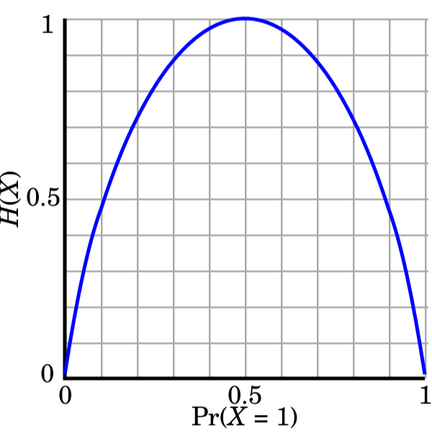
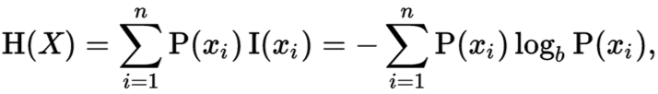
P=Q: Entropy
Abstract idea of “information” - usually measured in bits
Similar to digital bits: one bit = {0,1}, two bits = {0,1,2,3}, etc.
Entropy: information needed to specify a random variable
In expectation: can be fractional
Notes:
How is this useful in an operational sense?
Say:
P(x0) = 0.01 → I(x0) = log2(1/0.01) = 6.66
P(x1)=0.99 → I(x1) = log2(1/0.99) = 0.014
Sure, if we’re transmitting 0.014 bits 99% of the time, that’s a pretty low entropy (almost 0 bits required.) However in reality we’re constrained to only transmit integer bits. (See next slide.)

Slide 64
Brainstorming: Cross-Entropy Calculation
Next-Word Prediction:
Training data:
“This class is great when we talk about modern NN architectures”
“This class is difficult when we talk about complex NN architectures”
“This class is difficult when we talk about complex NLP questions”
Prediction Task:
“This class is [token]”
Token Options:
great, boring, difficult, easy
With same guess for p, if model ‘thinks’ q(‘great’) = q(‘boring’) = 0.5, what is the cross-entropy?

Slide 65
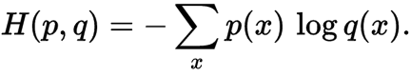
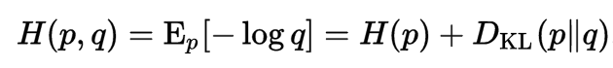
Cross-Entropy
Cross-entropy: measure of information encoding cost across distributions
P(x) = “true” distribution
Q(x) = predicted/estimated distribution
Given optimal encoding for Q, how many bits to encode p ~ P?

Slide 66
What if your probability distribution is wrong?
p = real; q = original guess
Expected encoding length = -∑p(x) lg q(x)
= -∑p(x) lg p(x) + [∑p(x) lg p(x) - ∑ p(x) lg q(x)]
= - ∑ p(x) lg p(x) + ∑ p(x) lg (p(x)/q(x))
= [Optimal encoding for p, had we known] + [extra because we were wrong]
= entropy(p) + KL Divergence (P || Q)

Slide 67
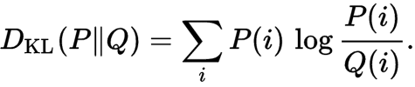
KL Divergence
KL-divergence explained
KL Divergence: measure of "distance*" between two distributions
P(x) = “true” distribution
Q(x) = predicted/estimated distribution
Given Q, how many bits (on average) to specify P?
* KL Divergence is not an actual distance metric (not symmetric).
Notes:
Is it fair to say KL Divergence is the difference between the optimal average number of bits and the operational number of bits as a result of our assumed distribution Q?
Maybe the question above could be: “Given Q, how many more bits on average to represent data with true distribution, P?”

Slide 68
Minimizing Cross-Entropy: Most-Common in NLP
Cross entropy is the general concept for probability distributions with multiple classes
Applied to logistic regression reduces into familiar loss
p(x) = real distribution, often 1-hot
q(x) = model estimated distribution
Since p(x) is (very) sharp, you get no loss if q(x) matches it exactly.

Slide 69
Cross-Entropy
Cross-entropy: measure of information encoding cost across distributions
P(x) = “true” distribution
Q(x) = predicted/estimated distribution
Given optimal encoding for Q, how many bits to encode p ~ P?

Slide 70
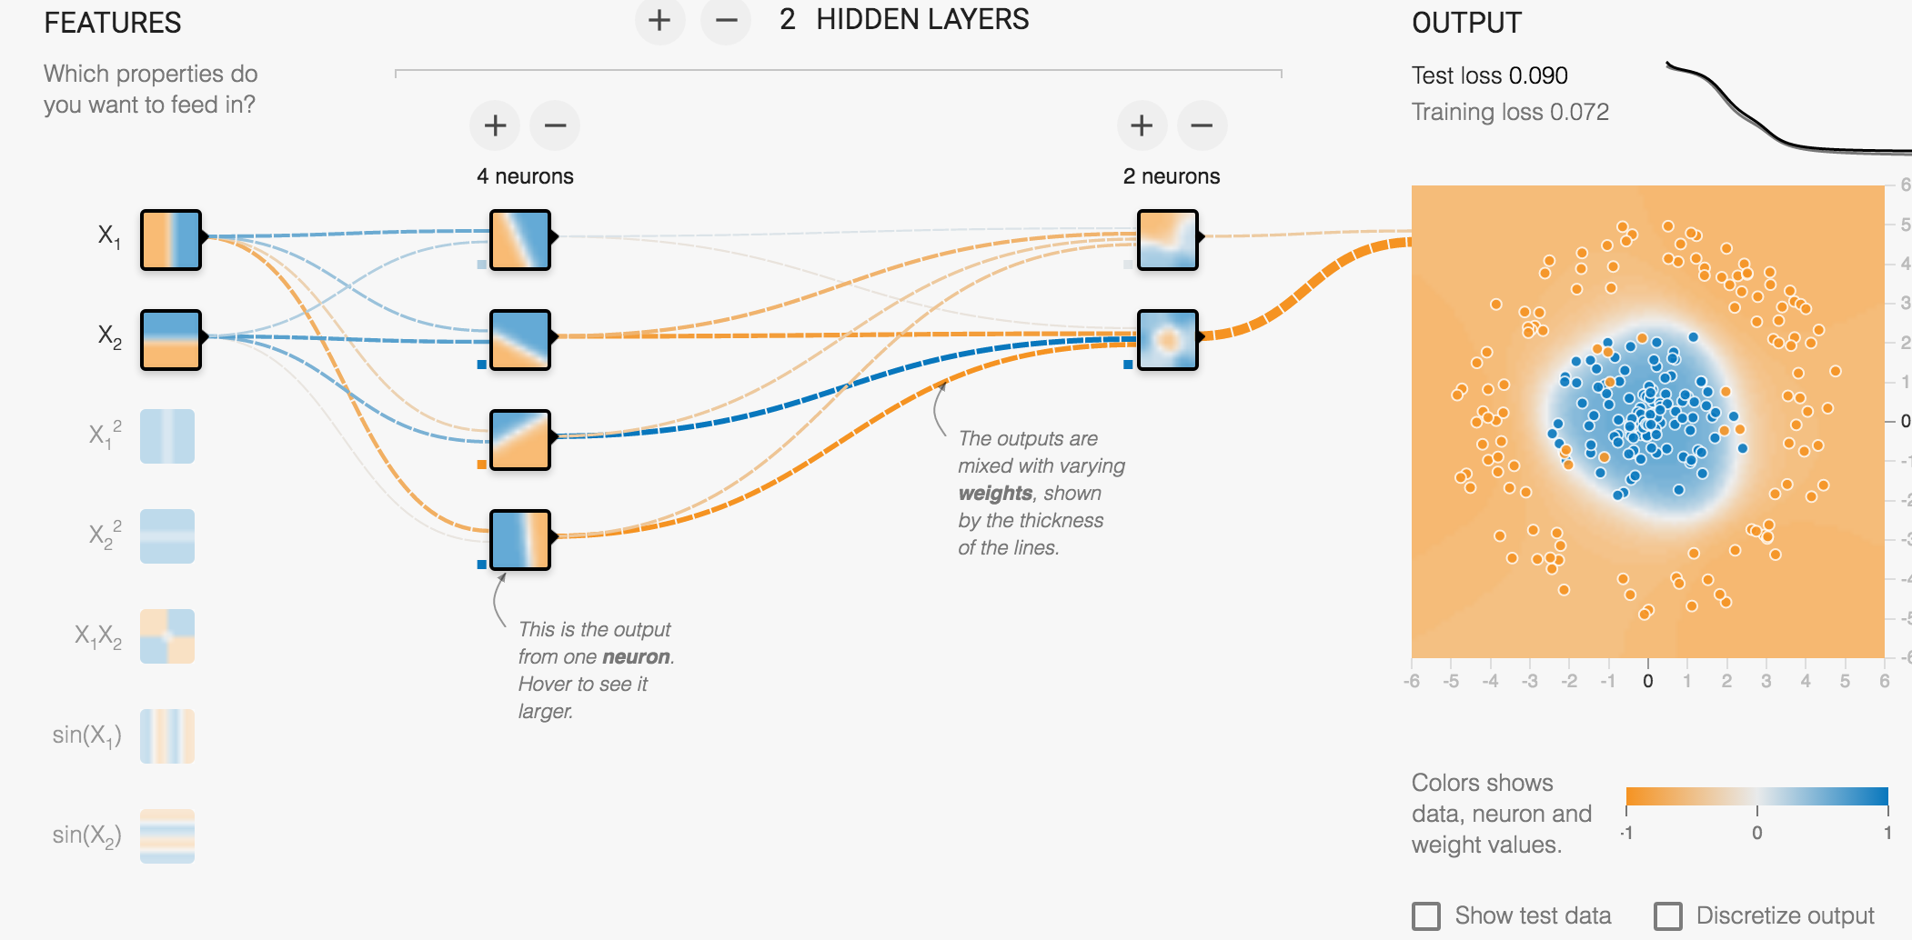
TensorFlow playground: http://playground.tensorflow.org/
Notes:
Also see https://colah.github.io/posts/2014-03-NN-Manifolds-Topology/ for more on how NN’s stretch and squeeze space to perform non-linear classification.

Slide 71
Fully-connected “Affine” Layer
h = f(x W + b)
Affine layer:
Matrix multiply W (rotate & scale)
Bias term b (translate in space)
Then:
Nonlinearity f (squish like dough)
Nonlinearity
Affine
From “Neural Networks, Manifolds, and Topology” (Chris Olah, 2014)
Notes:
One fully connected layer using a sigmoid is logistic regression!

Slide 72
Three labelled datasets to consider
If you don’t have a topic in mind, here are three labelled data sets from which you can choose:
Story Ending Classification – ROC Stories
Question Answering – SQUAD 2.0
Relation Extraction – TACRED

